Slide 1
Error Analysis & Data Manipulation
CH 361/H Experimental Chemistry I
Dr. Amila U. Liyanage
Fall 2019

Slide 2
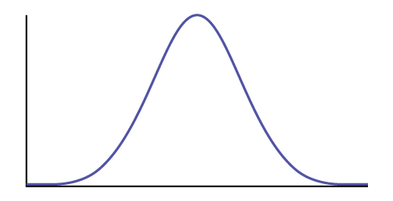
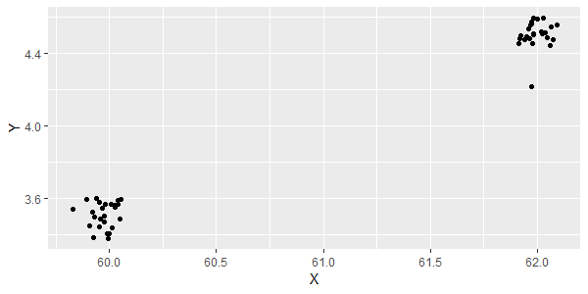
Quantitative Observations
Normal
(or Gaussian)
Distribution
of Population
In Chemistry, we make number of quantitative observations (N) via direct measurements.
We would observe statistically random variations in our measurements.
There are often cases where we may wish to discard data that looks discordant.

Slide 3
The Q-test for Discordant Data
https://www.science.oregonstate.edu/~gablek/CH361/Qtest.htm
Used for deciding if an outlier can be removed from a set of data.
If Q_{n} > Q_{c} reject outlier/suspect data point.
Then the rejected value should be excluded from any future statistical treatments (calculating mean, etc).
Note: Can only exclude one data point at most.
$$Q_{n}=\left|\frac{\left(x_{sus}−x_{near}\right)}{\left(x_{max}−x_{min}\right)}\right|$$
Q_{n} = Q value for the suspect data point (x_{sus})
x_{near} = Closest second data point
x_{max} - x_{min} = overall range of the data
N = number of observations | 3 | 4 | 5 | 6 | 7 | 8 | 9 | 10
Q_{c} | 0.94 | 0.76 | 0.64 | 0.56 | 0.51 | 0.47 | 0.44 | 0.41

Slide 4
What is the value we report?
https://www.science.oregonstate.edu/~gablek/CH361/Equations.htm
A single value that describes a set of data by identifying the central position within that set of data.
Mean – the average
Median – the middle number when listed in order from least to greatest
Mode – the number that occurred the most often in the data set
The most common "best value" to report is the mean.
$$\overline{x}=\frac{\left(Σx_{i}\right)}{N}$$
x̄ = sample mean
x_{i} = individual measurements
N = number of measurements
=AVERAGE(number1, [number2], …)

Slide 5
How good is our estimate?
https://www.science.oregonstate.edu/~gablek/CH361/Equations.htm
The range of the data can be reported indicating that the real value is "in there somewhere." Not a very satisfying answer.
By calculating the variance in the data we could provide a better answer, as this is theoretically related to the expected Gaussian distribution of data if we had time to make an infinite number of observations.
Measures how far a set of data is spread out.
S² = sample variance
x̄ = sample mean
x_{i} = individual measurements
N = number of measurements
$$S^{2}=\frac{Σ{\left(x_{i}−\overline{x}\right)}^{2}}{N−1}$$
=VAR.S(number1, [number2], …)

Slide 6
How good is our estimate?
https://www.science.oregonstate.edu/~gablek/CH361/Equations.htm
If we had an infinite number of observations, the variance approaches the square of the standard deviation for the population (σ).
Since we have limited data, the “better value” to report is the estimated standard deviation of the mean (S_{m}) which limits it to a description of our data rather than the theoretically infinite population of possible observations.
S_{m} = est. st. dev. of the mean S = square root of variance
x̄ = sample mean
x_{i} = individual measurements
N = number of measurements
$$S_{m}=\frac{S}{\sqrt{N}}$$
$$S_{m}=\frac{{\left(Σ{\left(x_{i}−\overline{x}\right)}^{2}\right)}^{1/2}}{\sqrt{N(N−1)}}$$

Slide 7
How good is our estimate?
https://www.science.oregonstate.edu/~gablek/CH361/Equations.htm
S_{m} measures how far the sample mean of the data is likely to be from the true population mean.
S_{m} can be used as a direct statement of precision.
Eg: 5.005 (2) - an uncertainty in the last significant figure.
However, it doesn't directly answer the question of "how good is the answer?“
In other words, how confidant are we that our estimate represents the true mean of the population?

Slide 8
How good is the answer?
https://www.science.oregonstate.edu/~gablek/CH361/ttest.htm
The confidence interval, can be defined at different levels of probability.
A 95% confidence interval is a range of values that you can be 95% certain contains the true mean of the population.
Δ = 95% confidence interval
t = t statistics (a value we read from the student t table)
S_{m} = estimated standard deviation of the mean
$$Δ=t{∙S}_{m}$$

Slide 9
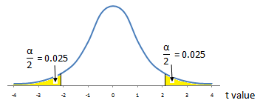
The Student’s t Distribution Table
https://www.science.oregonstate.edu/~gablek/CH361/ttest.htm
two-sided
95% confidence interval
→ Select P2 & t_{.95}
degrees of freedom (df)
$$df=N−1$$
N = number of observations

Slide 10
Finally, the result should be reported as
https://www.science.oregonstate.edu/~gablek/CH361/ttest.htm
$$\overline{x}±∆ (95\%, N=no. of observations)$$
Eg:
$$5.005±0.006 (95\%, N=5)$$
ΔG° at each temperature

Slide 11
Calculation of ΔH⁰ and ΔS⁰
$${∆G}^{0}=−RTlnK_{eq}$$
$${∆G}^{0}={∆H}^{0}−T{∆S}^{0}$$
$${∆G}^{0}=−{∆S}^{0}∙T+{∆H}^{0}$$
$$lnK_{eq}=\frac{−∆H^{o}}{R}\left(\frac{1}{T}\right)+\frac{∆S^{o}}{R}$$
$$y=m∙x+b$$
$$y=m∙x+b$$

Slide 12
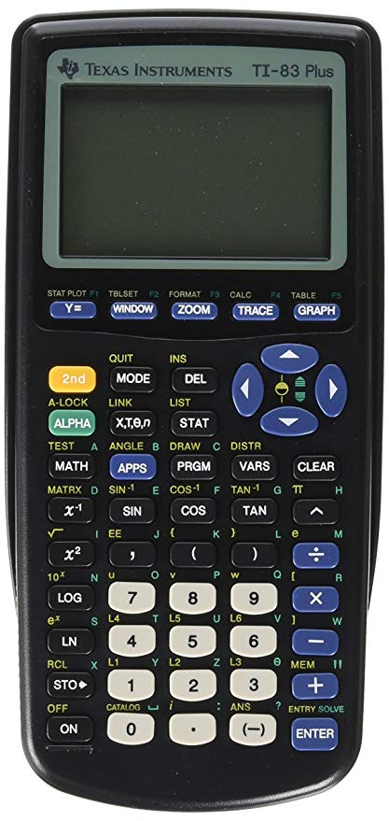
Linear Regression
https://www.science.oregonstate.edu/~gablek/CH361/LinearRegression.htm
If we have a simple linear model, we expect the data to behave according to y = mx + b.
Modern computer spreadsheets, statistical software, graphing calculators implement regression analysis.

Slide 13
Linear Regression
https://www.science.oregonstate.edu/~gablek/CH361/LinearRegression.htm
sums of squares
slope
intercept
$$S_{xx}=Σ\left(x_{i}^{2}\right)−\frac{{\left(Σx_{i}\right)}^{2}}{N}$$
$$m=\frac{S_{xy}}{S_{xx}}$$
$$b=\frac{Σ\left(y_{i}\right)}{N}−Σ\left(x_{i}\right)\frac{S_{xy}}{NS_{xx}}$$
$$S_{yy}=Σ\left(y_{i}^{2}\right)−\frac{{\left(Σy_{i}\right)}^{2}}{N}$$
$$S_{xy}=Σ\left(x_{i}y_{i}\right)−\frac{\left({Σx}_{i}\right)\left(Σy_{i}\right)}{N}$$
Variance in the slope
Variance in the intercept
$$S_{m}^{2}=S_{yy}−\frac{\frac{S_{xy}^{2}}{S_{xx}}}{\left(N−2\right)}$$
$$S_{b}^{2}=S_{m}^{2}\left(1+\left(\frac{1}{N}\right)−\frac{Σ{\left(x_{i}\right)}^{2}}{N}S_{xx}\right)$$

Slide 14
LINEST function in Excel
https://support.office.com/en-us/article/linest-function
=LINEST(known_y's, [known_x's], [const], [stats])
Note: Since LINEST returns an array of values, we must select a range consisting of 2 rows and 5 columns, enter the above formula, press Ctrl + Shift + Enter.

